Slide 1

FundFlow: Expense Tracking and Budget Management Application
FundFlow helps users efficiently manage expenses, budgets, and shopping lists. It includes an AI bot for financial insights.

Slide 2
Team Members
Soham Chavan
Sumeet Rane
Tejaswini Chavan
Prapti Sanghavi

Slide 3

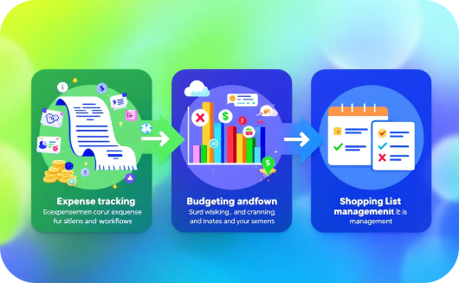

Why FundFlow?
Simplicity
Efficiency
Accessibility
Effortless financial management with an easy-to-use interface.
Streamlines expense tracking, budgeting, and shopping lists.
Empowers everyone to take control of their finances.

Slide 4

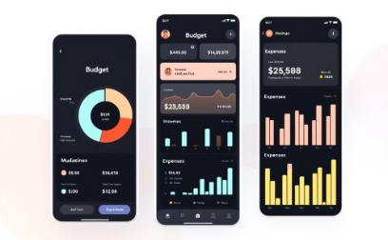
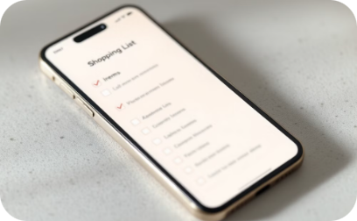
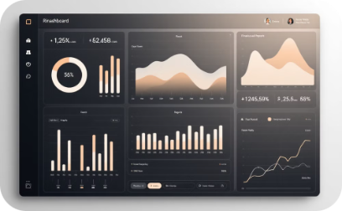

Key Features
Expense Tracking
Budgeting
Shopping List
Financial Insights
Categorize expenses easily.
Create budgets and receive alerts.
Manage your shopping list effortlessly.
Gain insightful reports and visualizations.
AI Assistant
Get financial assistance and insights.

Slide 5







Tech Stack
React
Node.js
MongoDB
Git
Powerful TypeScript library for building dynamic user interfaces.
Server-side JavaScript runtime environment for building robust backend systems.
Document-oriented database for storing and retrieving financial data.
Version control system for managing and collaborating on code.
TypeScript
Material UI
TypeScript is widely used in modern web development frameworks.
Material UI is an open-source React component library that implements Google's Material Design.

Slide 6
References
1. React and Material UI Documentation
• React: https://reactjs.org/docs/getting-started.html • Material UI: https://mui.com
2. Node.js Official Website • https://nodejs.org
3. MongoDB Documentation • https://www.mongodb.com/docs/
4. TypeScript Handbook • https://www.typescriptlang.org/docs/
5. Git Version Control • https://git-scm.com/doc
6. Design Principles • Google’s Material Design Guidelines: https://material.io/design

